Slide 1
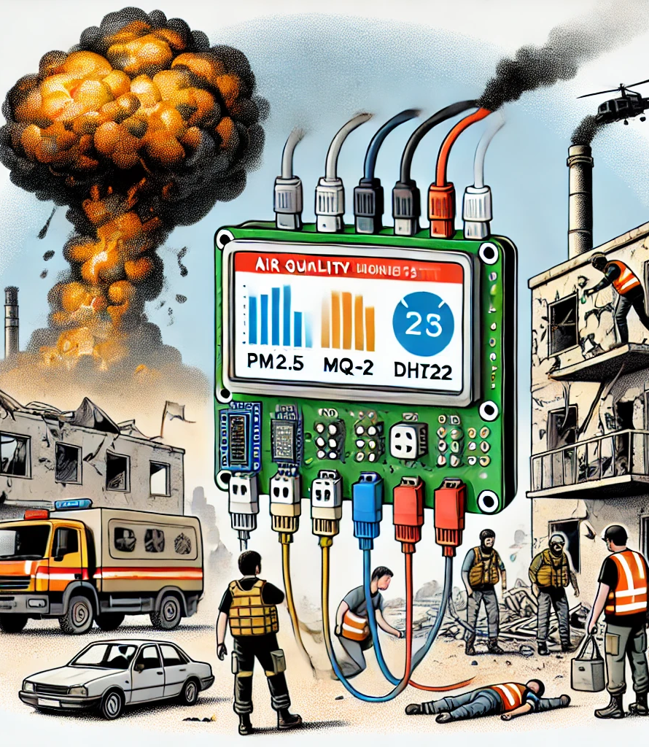
Air Quality Monitoring System for Conflict Zones: A Case Study of Gaza
Presented by : Mahmoud Kamal Abu Aisha
Supervised by: Dr. Ezzalden Edwan

Slide 2
Contents
Introduction
Methodology
Implementation
Related Work
Hardware Description
Conclusion
Proposed System
Software Description
Results
Future Scope

Slide 3
Introduction
The current Gaza crisis coupled with failing infrastructure has turned air pollution into a major medical danger in the region. The proposed solution develops a budget-friendly air quality monitoring device which supports offline operation and checks temperature and humidity alongside toxic gas and PM2.5 measurements. The device provides instant local alerts through buzzer sounds when dangerous standards from WHO and EPA reach limits so vulnerable communities get practical real-time hazard warnings.

Slide 4
Related Work
Several prior studies have proposed different approaches for air quality monitoring using Internet of Things (IoT) systems, utilizing low-cost and efficient hardware for real-time data collection and cloud integration. In [1], Maharana et al. developed an IoT-based real-time air quality monitoring system that utilized the ESP32 microcontroller alongside MQ-135 and DHT-11 sensors for detecting gases such as CO2, benzene, and ammonia. The system also integrated a cloud platform to transmit the data, ensuring the system's accessibility and providing real-time alerts when gas concentrations exceed safe limits.
Borade and Prakasarao in [2] presented a low-cost pollution measurement system employing the ESP32 and multiple sensors, including MQ-9 and DHT22. This system collected data on air quality parameters like CO, CO2, PM10, and other gases, transmitting the measurements via REST API to a cloud-based platform for further analysis and visualization.
The study by Azman et al. [5] focused on the use of ESP32 for indoor air quality monitoring, integrating various sensors such as MQ-2 and DHT11 to measure gas levels and environmental conditions like temperature and humidity. This system, powered by a solar panel, included a ventilation system that activated automatically based on detected gas levels, highlighting the potential for IoT systems to not only monitor air quality but also take corrective actions autonomously.
A study conducted by Mahetaliya et al. [6] proposed an air quality index monitoring system using ESP32, focusing on parameters such as PM2.5, CO, CO2, and environmental conditions. Their system integrates with ThingSpeak to provide real-time monitoring and data visualization. Alerts were triggered when pollutant levels crossed predefined thresholds, ensuring timely interventions.
These limitations highlight the need for a standalone, offline-capable air quality monitoring solution, which this project aims to fulfill by offering a low-cost, non-cloud-dependent system tailored specifically for Gaza’s wartime conditions

Slide 5
Proposed System
The project designs an independent air quality monitoring system intended for Gaza because security concerns combined with unstable power systems prevent usage of cloud-based monitoring. An ESP32 microcontroller along with sensors for temperature, humidity, gas and PM2.5 continuously analyzes atmospheric conditions by monitoring hazardous levels starting from temperature greater than 40°C and gas exceeding 750 ppm. When one or more set thresholds are breached the system emits a buzzer tone along with a local warning message. This system operates without dependence on internet connections or mobile applications because it is both reliable and low-cost while retaining portability which makes it suitable for shelters and homes during emergencies.
Component | Function
ESP32 | Main controller for sensor input and alarm activation.
DHT22 Sensor | Measures temperature and humidity with reliable accuracy.
MQ-2 Gas Sensor | Detects hazardous gases like carbon monoxide (CO), methane, and LPG.
PM2.5 Sensor | Monitors fine particulate matter, a key pollutant in war-affected zones.
20x4 I2C LCD | Displays real-time environmental data and alerts.
Piezo Buzzer | Sounds an alert when readings exceed safe limits.

Slide 6
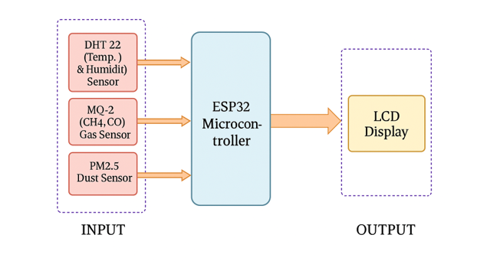
System Design
METHODOLOGY
The system is structured in three layers:
Data Gathers : Sensors (DHT22, MQ2, PM2.5) collect temperature, humidity, gas levels, and particulate matter.
Processing and Control: The ESP32 reads sensor data, interprets it, and checks against predefined safety thresholds.
Output and Alert: If danger levels are detected, the system activates a buzzer and shows a warning on an LCD; otherwise, it displays a “Good Air Quality” message.

Slide 7
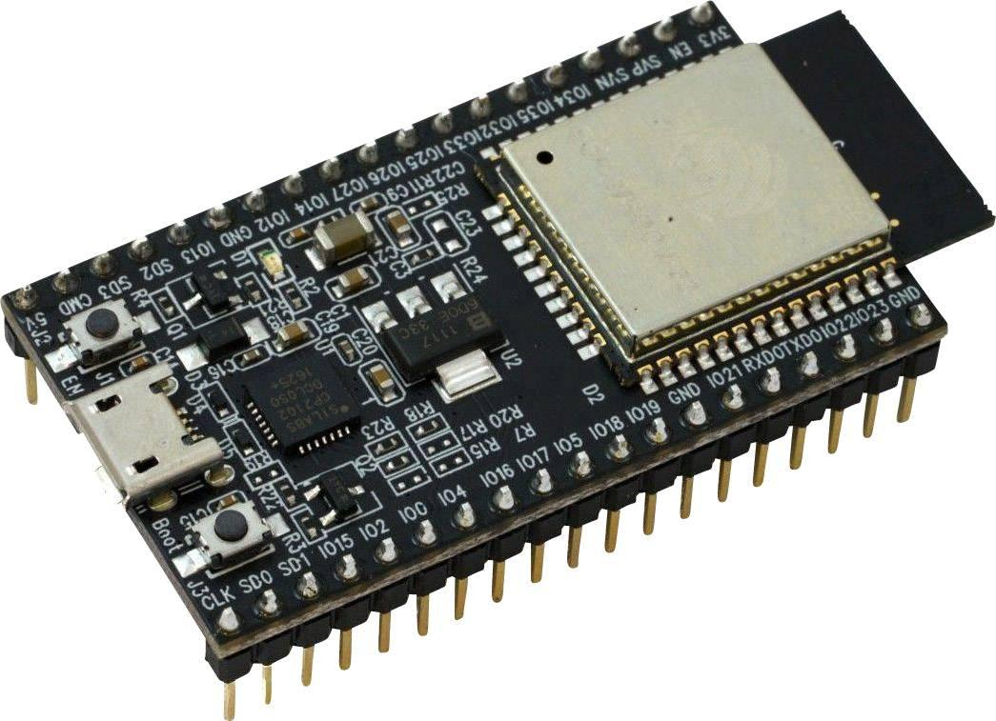
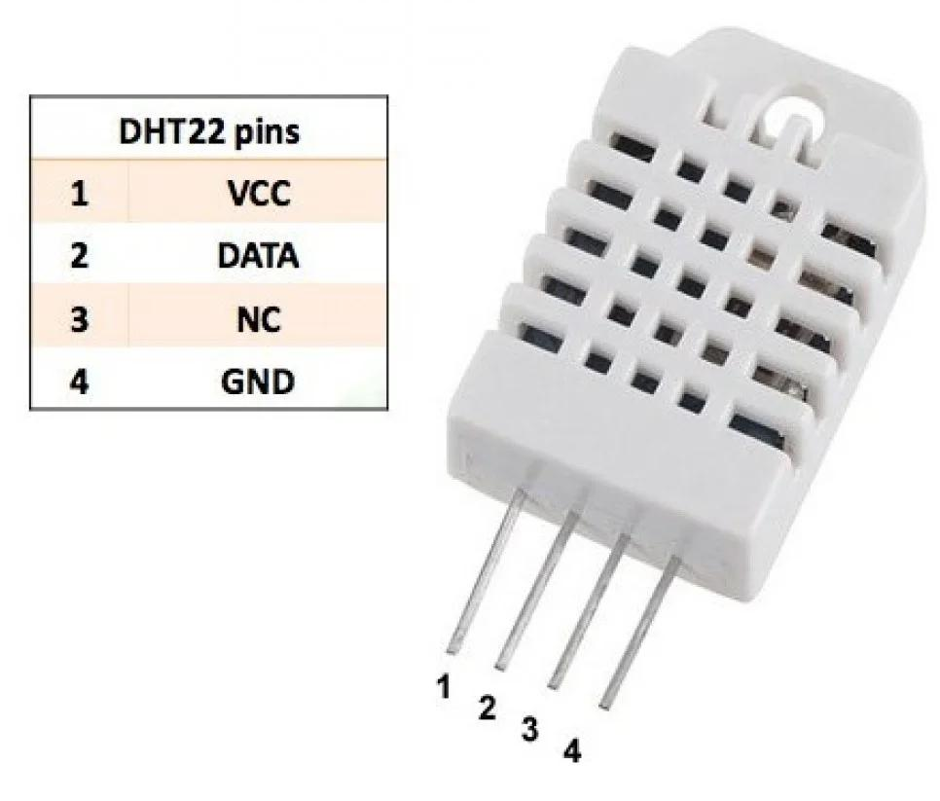
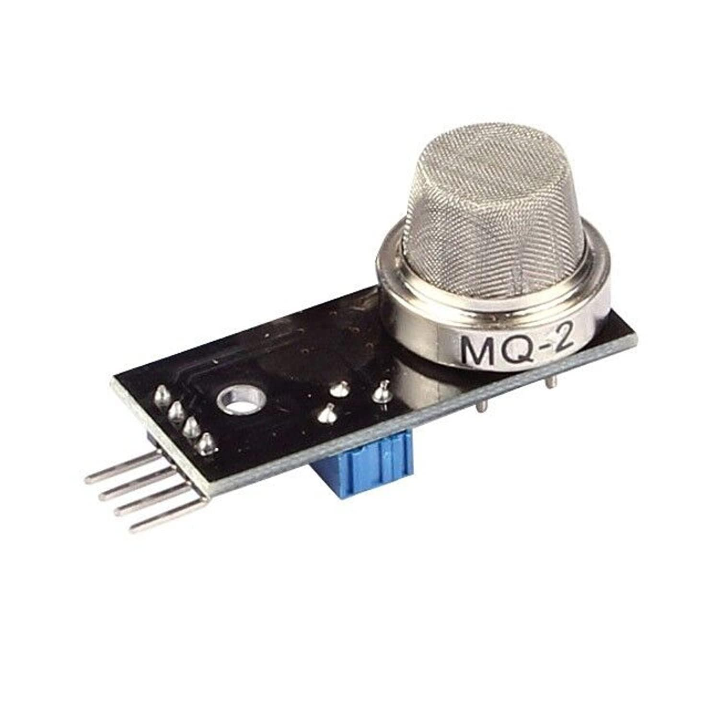
Hardware Description
The ESP32 is the system’s main controller. It’s a low-power, dual-core microcontroller with built-in Wi-Fi and Bluetooth, capable of reading sensor data and controlling outputs. Its flexibility and wide GPIO support make it ideal for IoT applications.
The DHT22 sensor measures temperature and humidity with high accuracy and stability. It provides a digital output, making it easy to use with microcontrollers and reliable over a wide temperature range.
The MQ-2 sensor detects flammable gases and smoke (like CH4, CO, and LPG) by providing analog readings based on gas concentration. It's popular in air quality systems for its quick response and low cost.

Slide 8
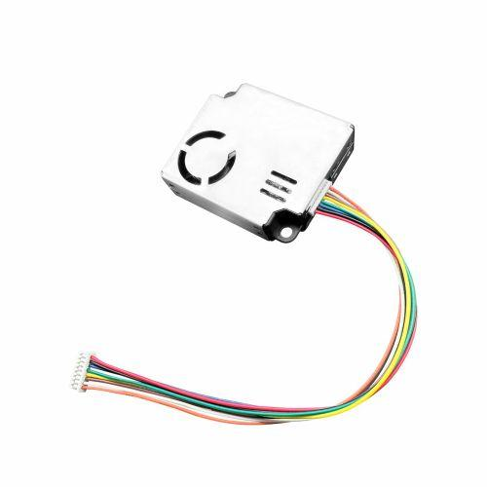
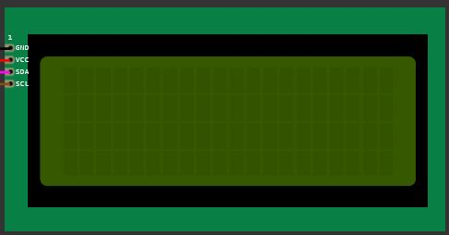
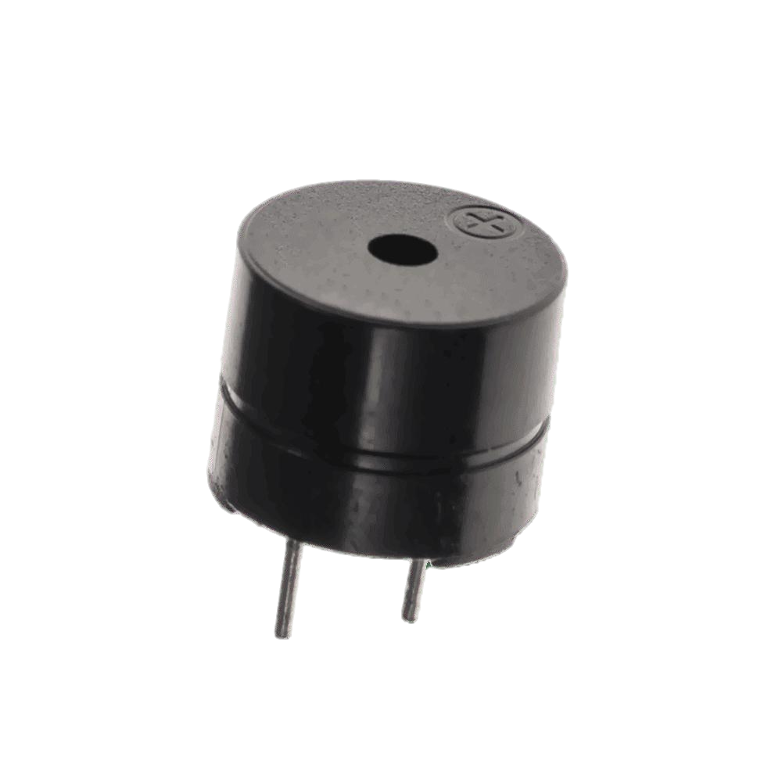
Hardware Description
PM2.5 Sensor: This sensor detects fine airborne particles (≤2.5 microns) that are harmful when inhaled. It provides analog/digital output and is vital for monitoring air quality.
20x4 I2C LCD Display: This display shows real-time sensor readings across four lines with 20 characters each. The I2C interface minimizes pin usage, simplifying communication with the ESP32.
Piezo Buzzer: The buzzer alerts users when air quality exceeds safe levels. It produces sound when triggered by a HIGH signal from the ESP32.

Slide 9
Hardware Description
Here are the detailed connection tables for each component and its corresponding connections to the ESP32:
1. ESP32 to DHT22 (Temperature and Humidity Sensor)
4. ESP32 to LCD (Display)
ESP32 Pin | DHT22 Pin | Description
VCC | Pin 1 (VCC) | Power (3.3V or 5V, depending on your setup)
GND | Pin 4 (GND) | Ground
GPIO 4 | Pin 2 (DATA) | Data (Used for communication)
ESP32 Pin | LCD Pin | Description
VCC | Pin 1 (VCC) | Power
GND | Pin 2 (GND) | Ground
GPIO 22 | Pin 3 (SDA) | I2C Data (connect to GPIO22)
GPIO 23 | Pin 4 (SCL) | I2C Clock (connect to GPIO23)
2. ESP32 to MQ-2 (Gas Sensor)
5. ESP32 to Piezo Buzzer
ESP32 Pin | MQ-2 Pin | Description
VCC | Pin 1 (VCC) | Power (3.3V or 5V, depending on your setup)
GND | Pin 2 (GND) | Ground
GPIO 5 | Pin 3 (A0) | Analog Output (connect to ADC pin, like GPIO5)
ESP32 Pin | Buzzer Pin | Description
GPIO 18 | Pin 1 (Positive) | Control signal for the buzzer (connect to GPIO18)
GND | Pin 2 (Negative) | Ground
3. ESP32 to PM2.5 (Dust Sensor)
ESP32 Pin | PM2.5 Pin | Description
VCC | Pin 1 (VCC) | Power (typically 5V for most PM2.5 sensors)
GND | Pin 2 (GND) | Ground
GPIO 15 | Pin 3 (OUT) | Digital Output (connect to GPIO15 for digital communication)

Slide 10
Software Description
The software is written C++ using libraries for sensors and LCD control. It reads and processes sensor data, activating a buzzer and warning when thresholds are exceeded. The system was developed and tested virtually using the Wokwi simulator, without needing physical hardware.
Mathematical and Logical Operations
MQ2 Gas Sensor: Outputs analog values (300–900). The voltage is calculated using the formula: Vout = (analogValue / 4095) × 5. If Vout exceeds 3.5V (approx. value > 716), it triggers an alert.
DHT22 Sensor: Provides direct temperature and humidity readings. Alerts are triggered if temperature > 35°C or humidity > 70%.
PM2.5 Sensor (Simulated): Provides direct values in µg/m³. If the value exceeds 100 µg/m³, the air is considered polluted.
Decision Logic: The system checks if any of the following are true:
Temperature > 35°C
Humidity > 70%
MQ2 reading > 716
PM2.5 > 100 µg/m³ If so, it activates the buzzer and displays "Poor Air Quality" on the LCD. Otherwise, it turns off the buzzer.
5. Summary Table
Sensor | Raw Value | Computation | Threshold / Effect
MQ2 | Analog (300–900) | Vout = (value / 4095) × 5V | Vout > 3.5V or value > 716 ⇒ Trigger
DHT22 Temp | Direct (°C) | None | Temp > 35°C ⇒ Trigger
DHT22 Humid | Direct (%) | None | Humidity > 70% ⇒ Trigger
PM2.5 | Direct (µg/m³) | None / Simulated | PM2.5 > 100 ⇒ Trigger

Slide 11
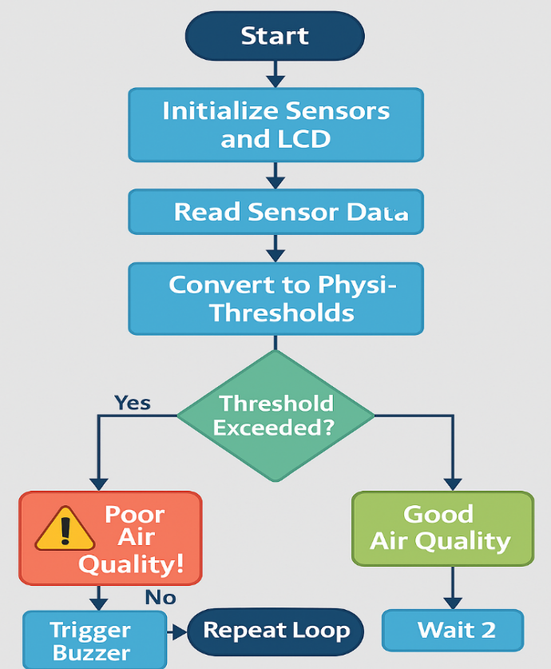
System Flowchart Overview

Slide 12
IMPLEMENTATION
The following is the full code used to operate the air quality monitoring system:
#include <Wire.h> #include <LiquidCrystal_I2C.h> #include <DHT.h> #Define BUZZER 27 const float TEMP_THRESHOLD = 35.0; const float HUM_THRESHOLD = 70.0; const int GAS_THRESHOLD = 716; lcd. backlight (); lcd. setCursor (0, 0); lcd.print (" Air Quality System"); delay (2000); lcd. clear (); pinMode (BUZZER, OUTPUT); noTone (BUZZER); } void loop () { float temperature, humidity; int gasValue, pm25; if (counter % 4! = 3) { temperature = random (250, 340) / 10.0; humidity = random (400, 690) / 10.0; | gasValue = random (300, 710); bool alert = ( gasValue > GAS_THRESHOLD || temperature > TEMP_THRESHOLD || humidity > HUM_THRESHOLD || pm25 > PM_THRESHOLD); Serial. Print ("Temp: "); Serial. Print(temperature); Serial. Print ("°C | Hum: "); Serial. Print(humidity); Serial. Print ("% | Gas: "); Serial. Print(gasValue); Serial. Print (" | PM2.5: "); Serial.println(pm25); lcd. clear (); lcd. setCursor (0, 0); lcd.print("T:"); lcd.print (temperature, 1); lcd.print((char)223); lcd.print ("C H:"); | lcd.print (humidity, 0); lcd.print ("%"); lcd. setCursor (0, 1); lcd.print("G:"); lcd.print(gasValue); lcd.print (" P:"); lcd.print(pm25); lcd. setCursor (0, 2); if (alert) { tone (BUZZER, 1000); lcd.print ("⚠ Poor Air Quality!"); } else { noTone (BUZZER); lcd.print ("Good Air Quality "); } counter++; delay (2000); }

Slide 13
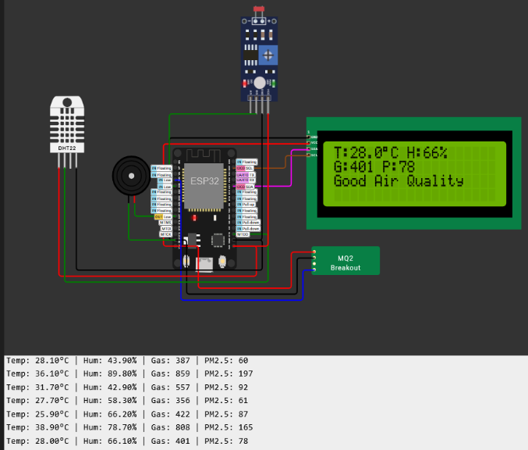
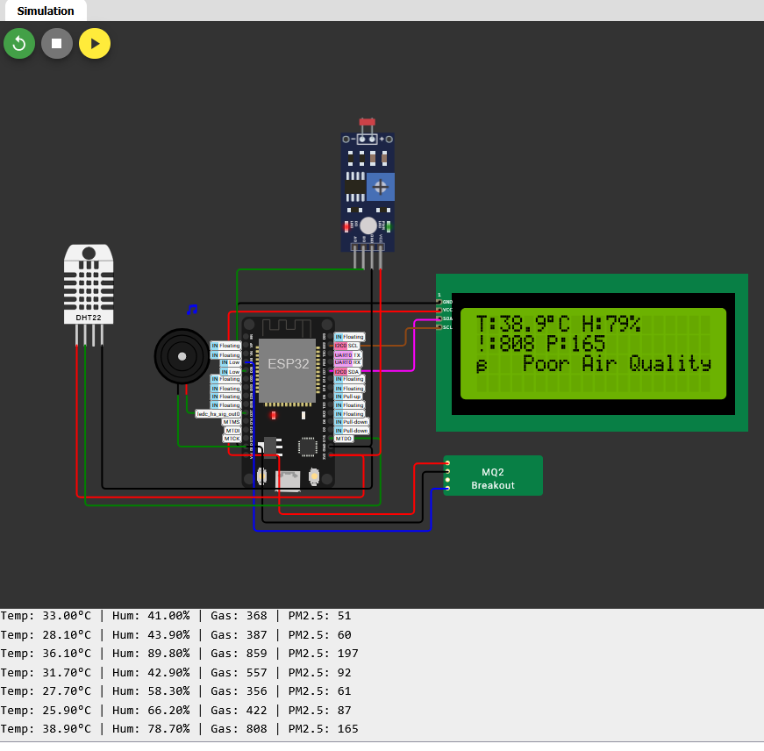
implementation

Slide 14
RESULTS
The system was tested using the Wokwi simulator under three scenarios:
Normal Air Quality: All sensor values were within safe limits. The system displayed “Good Air Quality” and kept the buzzer off.
Polluted Environment: Sensor readings exceeded thresholds (e.g., temp > 40°C, gas > 800, PM2.5 > 120). The system triggered a buzzer and showed a “⚠️ Poor Air Quality!” warning.
Dynamic Variation: Simulated alternating conditions—three normal cycles followed by a polluted one. The system responded correctly, confirming alert reliability.
Overall, the system accurately read sensor data, displayed alerts instantly, and reliably reset when conditions improved. These results confirm its effectiveness in offline, crisis-prone environments like Gaza.

Slide 15
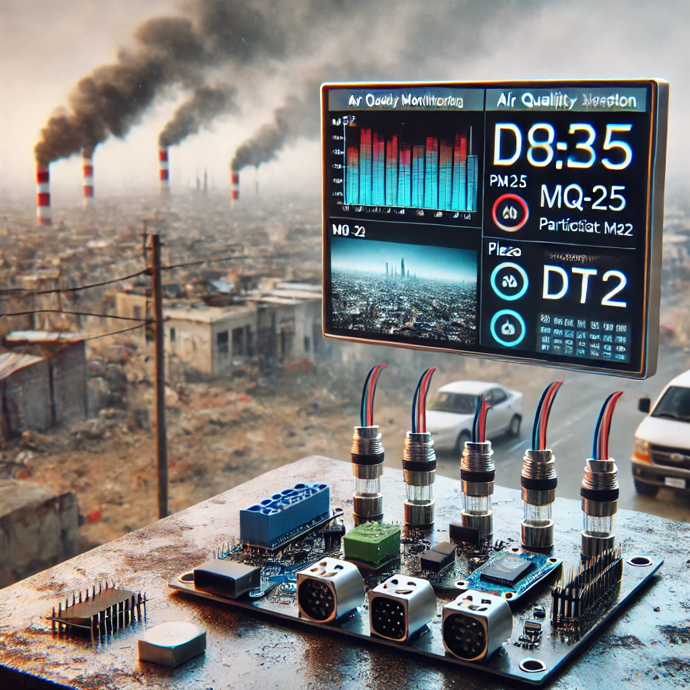
CONCLUSION
This project developed a low-cost, real-time air quality monitoring system for crisis zones like Gaza, using an ESP32 and sensors (DHT22, MQ-2, PM2.5) without internet reliance. It delivers instant alerts via LCD and buzzer when thresholds are exceeded, proving effective in Wokwi simulations. The system's design makes it ideal for use in shelters and homes, helping raise public health awareness and address environmental risks.

Slide 16
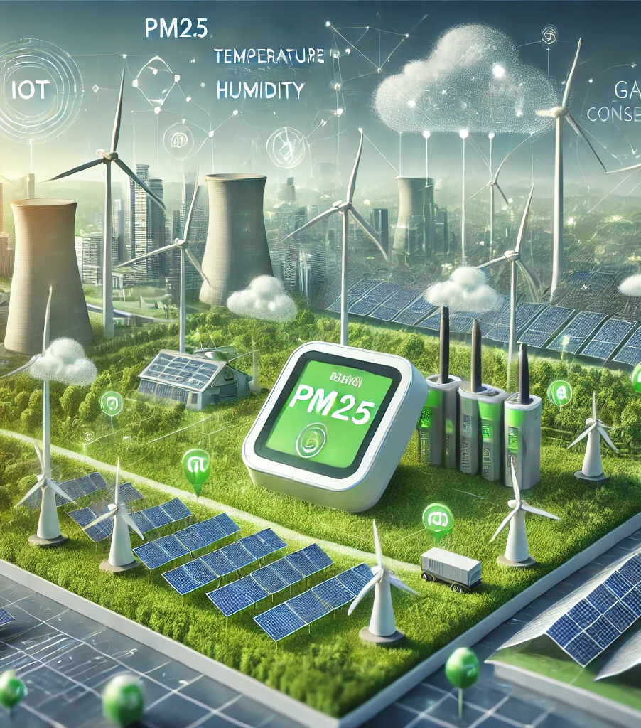
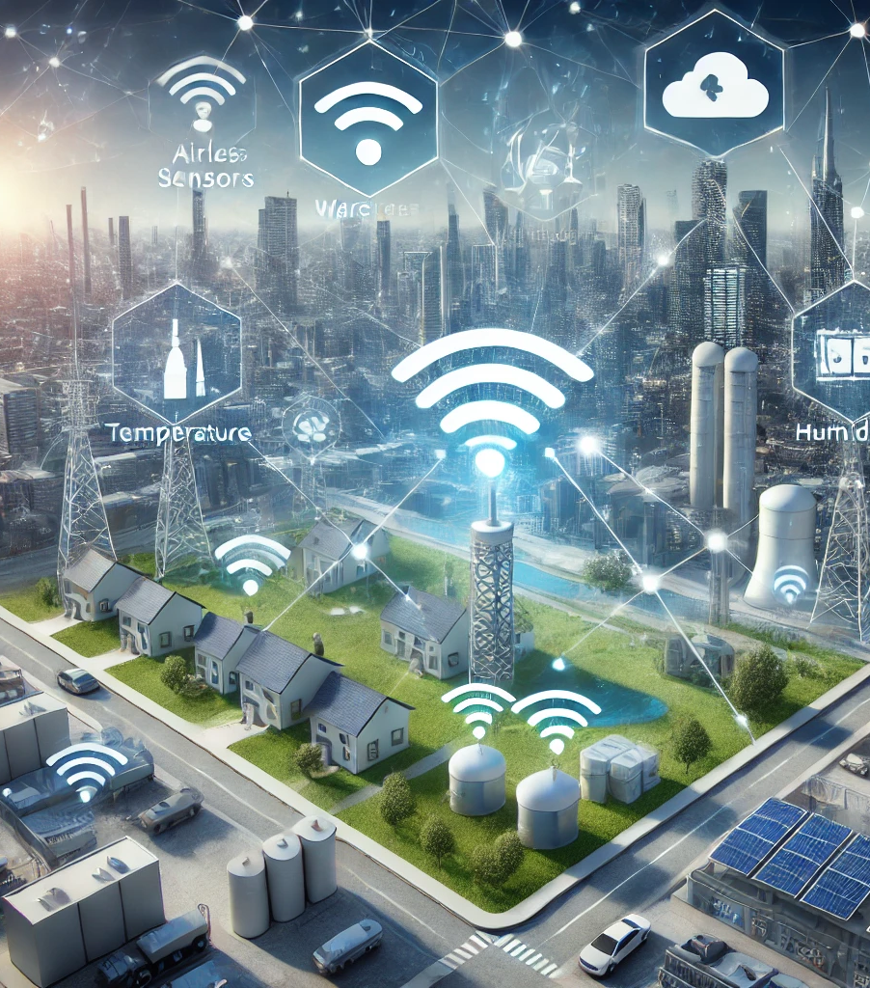



FUTURE SCOPE
Integration with Renewable Energy
Wireless Alert Systems
Mobile Application Support
Additional Sensors
Data Logging and Analysis

Slide 17



Thank you
Mahmoud Abu Aisha
mk.abuaisheh@std.alaqsa.edu.ps

